Slide 1
Most used Regression Models
The most used Regression Models

Slide 2
Linear and Polynomial Regression
We already saw it!

Slide 3

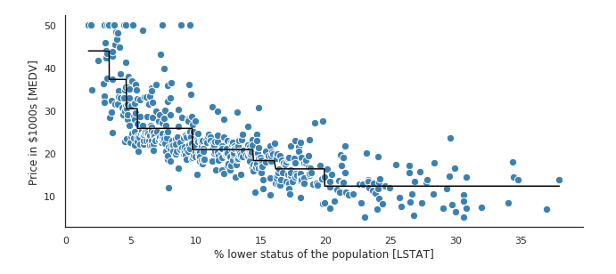
Decision Tree Regressor
Decision Tree Regressor is an recursive partitioning of the data.

